Slide 1


Topological Data Analysis on Music Data
Team Members: Yash Gangrade – u1143811, Siddhant Ranade – u1141131
April 2, 2019
Presented By:
Yash Gangrade
MS in Computing
University of Utah

Slide 2
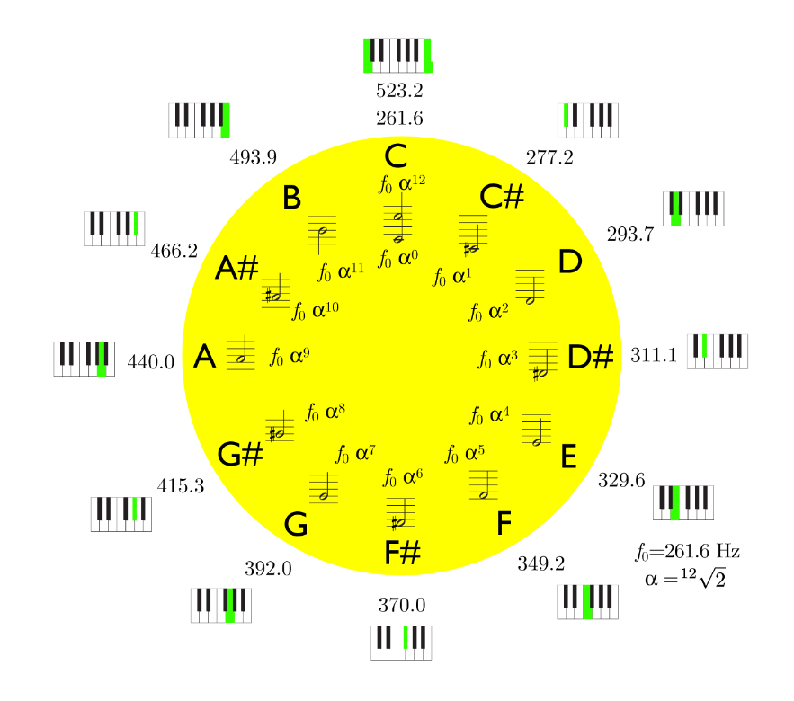
Background and Motivation
Music in general is rich in structures. If one looks at the sequence of notes that make up a song, one can usually find repeating patterns, for instance, verses will often have exactly the same tune. Observing carefully, it can be observed that certain phrases (or structures) occur more frequently.
Fig. 1: Artistic impression of the surface of Mars*
*Source: Bladin et al., Globe Browsing: Contextualized Spatio-Temporal Planetary Surface Visualization

Slide 3

Outline
Background and Motivation
Introduction and Problem Statement
Related Works
Methodology and Solutions
Simulation Results
Conclusion
References

Slide 4
Background and Motivation
Study of celestial bodies has always been intriguing to mankind and it plays an important role in mythology and understanding of the laws of physics.
The authors in this paper are motivated to visualize and use the huge amount of data available from space exploration to unravel mysteries of the universe.
Fig. 1: Artistic impression of the surface of Mars*
*Source: Bladin et al., Globe Browsing: Contextualized Spatio-Temporal Planetary Surface Visualization

Slide 5
Background and Motivation ☑
Introduction and Problem Statement
Related Works
Methodology and Solutions
Simulation Results
Conclusion
References

Slide 6
Introduction
Over the years, NASA and other space agencies have sent multiple spacecrafts and orbiters to outer space for collecting data from different celestial bodies.
This spacecraft based exploration has provided us with detailed imagery and surface data from various celestial bodies of our solar system.
Analysis and visualization of this data has enabled numerous scientific discoveries about the properties of the planets. Ex. finding water on Mars.

Slide 7
Problem Statement
The authors here focused on developing visualization tools and applications for communication of these discoveries and the engineering efforts behind it.
This work aims at developing the tools necessary for interactive visualization of the raw data fetched by satellites and probes.
Application of the visualization tool to the data of three celestial bodies.

Slide 8
Principles guiding the Paper
Visualization should be data-driven and thus only data derived from the instruments on space probes should be used.
Data from multiple data sources should be merged.
The maximum available resolution in space and time should be accessible on demand for the areas of the interest.
Data should be as current as possible by enabling access to a range of curated and frequently updated repositories.
*Source: Bladin et al., Globe Browsing: Contextualized Spatio-Temporal Planetary Surface Visualization

Slide 9
Motivation and Scope ☑
Introduction and Problem Statement ☑
Related Works
Methodology and Solutions
Simulation Results
Conclusion
References

Slide 10
Related Works
Authors have linked several previous works in the field of planetary visualization.
Science Communication: Interactive Visualization by Ynnerman et al. 2016
Astronomical Visualization: Eyes on the Solar System by NASA, Hussey, 2010
Geographic Information Systems (GIS): Global Positioning System, Cozzi, 2011
Level-of-detail globe rendering: Several approaches in this field.
Stereoscopic reconstruction: 3D surface reconstruction by Koch, 1995

Slide 11
Motivation and Scope ☑
Introduction and Problem Statement ☑
Related Works ☑
Methodology and Solutions
Simulation Results
Conclusion
References

Slide 12
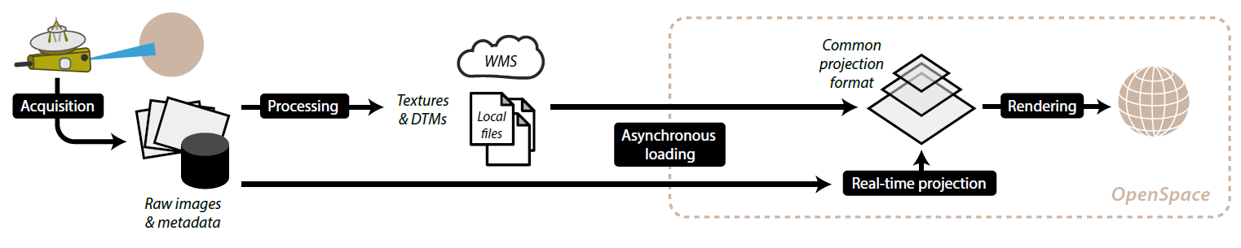
Fig. 2: Illustration of the processing pipeline of the visualization tool [1]
*Source: Bladin et al., Globe Browsing: Contextualized Spatio-Temporal Planetary Surface Visualization

Slide 13
Data Scenarios and Acquisition - Mars
Several orbiters and landers have been sent to Mars. Most important one is Mars Reconnaissance Orbiter (MRO) equipped with an array of cameras, spectrometers, and radar used to image the surface.
Other datasets are Mars Global Digital Image Mosaic (MDIM), Context Camera, Mars Orbiter Laser Altimeter, HiRISE images etc.
Main challenge in the Mars browsing application arise from handling these datasets at various resolutions in a single context. It requires layer handling and ability to render map data accurately with varying levels of detail.

Slide 14
Data Scenarios and Acquisition - Earth
Thick atmosphere of earth hinders the acquisition of detailed surface but hundreds of earth observing satellites in the orbit provide a good coverage.
Authors focused on three sub-synchronous satellites which returned images of Earth daily and each of them covered the majority of the surface area.
There are several other datasets provided by different institutions.

Slide 15
Data Scenarios and Acquisition - Pluto
The images of the previous two scenarios were acquired by orbiting satellites providing the ability to produce images for an extended period of time.
Pluto is a part of non-orbiting mapping campaign performed by New Horizons spacecraft in July 2015.
The time varying resolutions provide an opportunity to show the incremental image acquisition rather than using a static planetary map of varying resolution.

Slide 16
*Source: Bladin et al., Globe Browsing: Contextualized Spatio-Temporal Planetary Surface Visualization

Slide 17
Globe Browsing System
Once the data has been acquired, authors described the aspects of the rest of the pipeline and the details of implementation for three application scenarios. The individual components of the process are listed below:
Data Access
Data Preparation
Real-Time Image Projection
Rendering System
Multi Display Systems Rendering

Slide 18
Data Access
All the data accessible by the system has to be presented as image data.
For global image sources, common pattern used is web-based level of detail service called the Web Map Service (WMS) [6]
The access to these online datasets in the system is unified by Geospatial Data Abstraction Library (GDAL) [7]
For iterative image projections, e.g. Pluto, individual images are loaded as they are produced and released by the astronomers team.

Slide 19
Data Preparation
To support the layering of multiple data sources, authors chose to employ the equirectangular geographic projection as a single unified projection format.
Essentially, in this section, author describes different conversion methods they used for the data obtained from different sources.

Slide 20
Real-Time Image Projection
To support the direct iterative visualization of spacecraft images acquisition, the system interfaces with various tools used in space planning and monitoring.
The information gathered is used to reconstruct the location and orientation of spacecraft along with specifications of the camera system.
Taking timing into the account, the images are projected and stored in an equirectangular global image map of the entire globe.
This map can then be used as a data source providing image data to renderer.

Slide 21
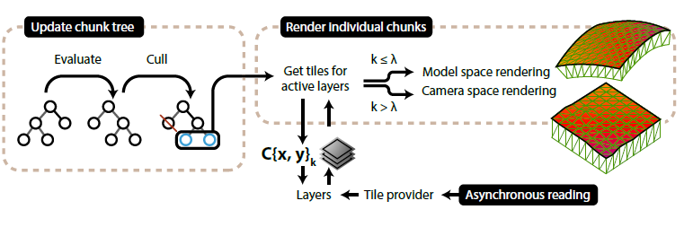
Rendering System
The rendering system is primarily driven by the rendering of the chunks which are organized into a quad-tree. Each chunk covers a particular geographic area of the planetary surface. Processing pipeline is shown below.
Fig. 3: Chunk tree processing and rendering pipeline overview*
*Source: Bladin et al., Globe Browsing: Contextualized Spatio-Temporal Planetary Surface Visualization

Slide 22
Rendering System
First, the chunk tree is processed to reflect the best fit for the given camera view. The chunk tree is then evaluated and chunks are either culled, split into child nodes, or merged. The resulting leaves are flagged for rendering.
Second, the system requests tile data from tile providers and will continue to render chunks with the currently available tiles. Tiles and layers are then combined in the fragment pipeline.
Third, Each chunk is rendered as a skirted regular grid mesh associated with a geodetic area and level of detail.

Slide 23
Chunk Processing
Chunk nodes are organized in a quad-tree and defined as C{x,y}_{k} for a geographic coordinate index (x , y) and detail level k.
Chunk Selection: selection is done using a unique error metric calculated on the fly using an approximation of the chunk’s projected area on a sphere.
Level Limitation: If a specific tile dataset does not contain any higher resolution tiles the maximum level of the chunk tree is limited.
Chunk Culling: To minimize the rendering calls, invisible chunks are culled. For horizon culling, maximum height of the chunk as bounding sphere is used.

Slide 24
Tile Management
A chunk is affected by multiple tiles that have a texture representing a geodetic area. Layers provide different semantic meaning for groups of tiles.
Each layer has a corresponding tile provider that the renderer will query using the tile index, representing the corresponding chunk to render.
After the processing, once the image data is ready, a tile is created and uploaded to GPU memory as a texture. The tile provider uses an in-memory least recently used (LRU) cache so that it can return a cached tile upon request.

Slide 25
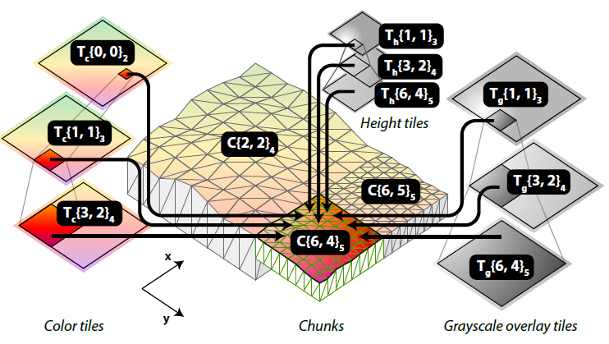
Chunk Rendering
Given a chunk tree, each chunk that is flagged as visible is rendered individually.
Each time a chunk needs to be rendered, all active layers will be queried for the most appropriate tiles. If the requested resolution level is not available, lower levels will be used.
Fig. 4: Rendering chunk C{6,4}₅ by combining the information from 9 tiles. *
*Source: Bladin et al., Globe Browsing: Contextualized Spatio-Temporal Planetary Surface Visualization

Slide 26
Chunk Rendering
Authors briefly describes the four rendering techniques for vertex positioning to account for both accuracy and precision.
Model-space rendering
Camera-space rendering
Combined model and camera-space rendering
Fragment Blending – This itself has three types namely, Layer group blending, Layer blending, and Level blending.

Slide 27
Time Varying Datasets
A time stamp corresponding to the current simulation time is used to instantiate a tile provider for any given time step. The system store a template defining the dataset without a specific time stamp.
When a tile is called, and the corresponding tile provider needs to be created, the time stamp key is replaced with a time stamp and a new dataset is opened.
Memory buffering is important for temporal datasets because opening datasets and streaming tile data on demand can cause delay in tile loading.
Memory buffering can either be performed by pre-caching tiles when initializing the software or by browsing to the specific time intervals and let the tiles load as they are requested.

Slide 28
Background and Motivation ☑
Introduction and Problem Statement ☑
Related Works ☑
Methodology and Solutions ☑
Simulation Results
Conclusion
Research

Slide 29
Globe Browsing on Mars
Fig. 5: Browsing the surface of Mars in a clustered environment rendering on the power wall at the University of Utah. The system uses eight rendering nodes, each connected to four screens. *
The Mars globe browsing sessions have been used in a large number of public presentations to explain the history of Mars exploration, and the ability to contextualize events pertaining to the rovers on the surface.
*Source: Bladin et al., Globe Browsing: Contextualized Spatio-Temporal Planetary Surface Visualization

Slide 30
Demonstration for Mars, Earth & Pluto
Fig. 6: a) High Resolution terrain and texture on Mars; b) Time varying datasets on Earth. *
This particular demonstration also used an implementation of atmospheric effects as proposed by Elek [8]. It enables more realistic representations of the celestial bodies.
*Source: Bladin et al., Globe Browsing: Contextualized Spatio-Temporal Planetary Surface Visualization

Slide 31
Visualizing Acquisition on Pluto
Fig. 7: OpenSpace was used to visualize how New Horizons captured images of Pluto on July 14th, 2015. Sites from all over the world connected in a live event during the flyby. The image shows the New York site with host Neil deGrasse Tyson*
*Source: Bladin et al., Globe Browsing: Contextualized Spatio-Temporal Planetary Surface Visualization

Slide 32
Background and Motivation ☑
Introduction and Problem Statement ☑
Related Works ☑
Methodology and Solutions ☑
Simulation Results ☑
Conclusion
References

Slide 33
Conclusion
Authors here have presented a robust application which enables data-driven visual browsing of planetary surfaces with dynamic resolution in space and time. This visualization provides the scientists a new viewpoint to understand the science of outer space and heavenly celestial bodies
The spacecraft pilot’s perspective of the planetary terrain and surfaces in the visualization provides new insights and perspectives for future manned missions
The astro-visualization software i.e. OpenSpace used here provides a seamless environment which allows the user to go from one point to another in the space and even changing the time of visualization i.e. go to past or view real-time data

Slide 34
Background and Motivation ☑
Introduction and Problem Statement ☑
Related Works ☑
Methodology and Solutions ☑
Simulation Results ☑
Conclusion ☑
References

Slide 35
References
[1] Bladin et al: Globe Browsing: Contextualized Spatio-Temporal Planetary Surface Visualization. IEEE Vis, 2017
[2] A. Ynnerman, T. Rydell, D. Antoine, D. Hughes, A. Persson, and P. Ljung. Interactive visualization of 3D scanned mummies at public venues. Communications of the ACM, 59(12):72–81, 2016.
[3] K. J. Hussey. “Eyes On The Solar System” a real-time, 3D-interactive experience for planetaria and beyond. In European Planetary Science Congress 2010, vol. 1, p. 50, 2010.
[4] P. Cozzi and K. Ring. 3D engine design for virtual globes. CRC Press, 2011.
[5] R. Koch. 3-D surface reconstruction from stereoscopic image sequences. In Proceedings of IEEE International Conference on Computer Vision, pp. 109–114, Jun 1995. doi: 10.1109/ICCV.1995.466799
[6] J. Maso, K. Pomakis, and N. Julia. OpenGIS web map tile service implementation standard. Open Geospatial Consortium Inc, pp. 04–06, 2010.
[7] F. Warmerdam. The geospatial data abstraction library. In Open source approaches in spatial data handling, pp. 87–104. Springer, 2008
[8] O. Elek. Rendering parametrizable planetary atmospheres with multiple scattering in real-time. In Proceedings of the Central European Seminar on Computer Graphics. Citeseer, 2009

Slide 36
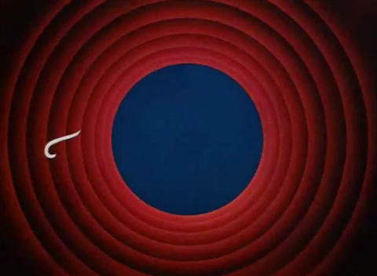
“
Thank you!
Questions?
“

